Slide 1
Deep Learning
Generated for: RNNs, Deep Learning
Notes:
Welcome to the Deep Learning presentation covering multiple topics. Today we'll explore: RNNs, Deep Learning.

Slide 2
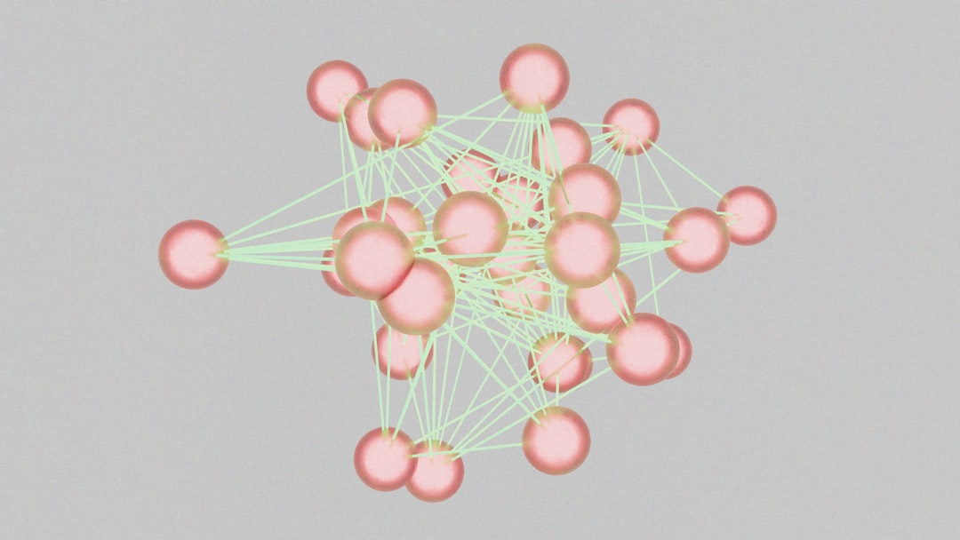
RNNs - Introduction
Recurrent Neural Networks process sequential data
RNNs have feedback connections for temporal relationships
Used for language modeling and text generation
Effective for speech recognition and machine translation
RNNs can learn from experience and adapt
Basic RNN architecture includes input and output
Hidden state captures sequential information
Training RNNs involves backpropagation through time
RNNs are a type of deep learning model
Inspired by biological neural networks
Notes:
When introducing RNNs, emphasize their ability to handle sequential data, such as time series or natural language. Explain how the feedback connections allow the model to capture temporal relationships. Provide examples of applications, such as language translation or speech recognition, and ask students to think about how RNNs can be used in these contexts. Discuss the basic architecture and how the hidden state is used to capture sequential information. Key takeaways include understanding the role of RNNs in deep learning and their ability to learn from experience and adapt to new data.

Slide 3

RNNs - Introduction
Recurrent Neural Networks process sequential data
RNNs have feedback connections for temporal relationships
Used for speech recognition, language modeling tasks
Can learn from experience, adapt to new data
Basic RNNs suffer from vanishing gradient problem
Long Short-Term Memory networks mitigate this issue
RNNs can be trained using backpropagation algorithm
Applications include text classification, sentiment analysis
RNNs are suitable for time-series forecasting, prediction
Simple RNN equation: y = sigmoid(Wx + Uh)
Notes:
When introducing RNNs, emphasize their ability to handle sequential data and learn from experience. Provide examples of speech recognition and language modeling tasks. Explain the concept of feedback connections and how they enable RNNs to capture temporal relationships. Discuss the limitations of basic RNNs, such as the vanishing gradient problem, and how LSTMs address this issue. Use simple equations to illustrate the basic architecture of RNNs. Ask students to consider how RNNs can be applied to real-world problems, such as text classification and time-series forecasting.

Slide 4
RNNs - Architecture
Recurrent Neural Networks process sequential data
RNNs have feedback connections to previous states
Useful for time series forecasting and language modeling
Consist of input, hidden, and output layers
Hidden state captures sequential information
Training RNNs can be challenging due to vanishing gradients
Backpropagation Through Time is used for training
Simple RNN equation: h_t = sigmoid(Wx_t + Uh_{t-1})
Long Short-Term Memory networks are a variant
Gated Recurrent Units are another popular variant
Notes:
When explaining the architecture of RNNs, emphasize the importance of feedback connections and the role of the hidden state in capturing sequential information. Provide examples of time series forecasting and language modeling to illustrate the applications of RNNs. Discuss the challenges of training RNNs, such as vanishing gradients, and introduce the concept of Backpropagation Through Time. Write the simple RNN equation on the board and explain each component. Finally, mention the variants of RNNs, such as LSTM and GRU, and ask students to consider the advantages and disadvantages of each.

Slide 5
Deep Learning - Introduction
Deep learning is a subset of machine learning methods
Inspired by the structure and function of the brain
Uses artificial neural networks to analyze data
Enables computers to learn from experience
Improves performance with more data and computation
Key applications include image recognition and speech
Deep learning models can be supervised or unsupervised
Requires large datasets and computational resources
Used in self-driving cars and natural language processing
Enhances decision-making in various industries
Notes:
When introducing deep learning, emphasize its connection to machine learning and the brain's neural structure. Provide examples of deep learning applications, such as image recognition in self-driving cars and speech recognition in virtual assistants. Ask students to consider how deep learning improves with more data and computation. Key takeaways include the importance of large datasets and computational resources, as well as the potential for deep learning to enhance decision-making in various industries.

Slide 6
Deep Learning - Introduction
Deep learning is a subset of machine learning methods
Inspired by the structure and function of the brain
Uses artificial neural networks to analyze data
Can learn from large amounts of data automatically
Key applications include image recognition and speech
Deep learning models can be trained on various tasks
Requires significant computational resources and data
Has many real-world applications and uses cases
Can be used for both supervised and unsupervised learning
Notes:
When introducing deep learning, explain that it's a type of machine learning that's inspired by the brain's structure and function. Provide examples of how deep learning is used in image recognition and speech processing. Ask students if they have any experience with machine learning or neural networks. Discuss the importance of computational resources and large datasets in training deep learning models. Key takeaways should include the definition of deep learning, its applications, and the differences between supervised and unsupervised learning.

Slide 7
Deep Learning - Introduction
Deep learning is a subset of machine learning methods
Inspired by the structure and function of the brain
Uses artificial neural networks to analyze data
Can learn from large amounts of data automatically
Enables computers to perform complex tasks
Such as image recognition and natural language processing
Requires significant computational resources and data
Has many applications in industry and research
Includes techniques like convolutional and recurrent networks
Y = σ(WX + b) simple neural network equation
Notes:
When introducing deep learning, explain that it's a type of machine learning that's inspired by the brain's structure and function. Provide examples of how deep learning is used in real-world applications, such as self-driving cars and speech recognition systems. Ask students to consider the potential benefits and limitations of using deep learning in different contexts. Key takeaways include understanding the basics of neural networks and the importance of large datasets in training deep learning models.

